Slide 1
Unit 2: Opportunity Identification
Reference Text: Timmons, J. A., Spinelli, S., & Tan, Y. (2004). New venture creation: Entrepreneurship for the 21st century (Vol. 6)

Slide 2
Entrepreneurship as a Process
Identifying an Opportunity
Develop the Concept
Determine the Required Resources
Acquire the Necessary Resources
Implement and Manage
Harvest the Venture

Slide 3
Opportunity
Opportunity is a business concept, which if turned into a tangible product or service, by the enterprise, will result into profit. It is all about creating values

Slide 4
Networking
Creating & using contacts
Communicating effectively
Self marketing
Learning from experience
What do I want?
Personal goals
Skills & strengths
Confidence & self efficacy
Values & motivations
Planning:
Goals
What is success?
How-to?
Who with?
Resources
Creative thinking
Exploring ideas
Seeing needs as
opportunities
Taking initiative

Slide 5
Sources of innovative opportunity
Demographics
Changes in perception, meaning, and mood
New knowledge- Scientific or non-scientific
The unexpected—success, failure, or event
Innovation based on process need
Changes in industry or market structure

Slide 6
Sources of innovative opportunity
Natural resources
Existing anticipated industries
Market driven
Service sector scanning
Extension/ modification of present work content
Creative effort

Slide 7
Demographics
Changes in population, its size, age structure, composition, employment, education status, and income.
Demographics have major impact on what will be bought, by whom, and in what quantities.
Twentieth-century societies, both developed and developing ones, have become prone to extremely rapid and radical demographic changes, which occur without advance warning.

Slide 8
Current Trends
Aging population
Energy costs rising
Marital status changes
Families without children
Leisure time growing
Health & physical fitness
Personal care
Financial planning

Slide 9
Changes in Perception
When a change in perception takes place, the facts do not change. Their meaning does.
It is not always apparent which is fad and which is true change.
Perception-based innovation has to start small and be very specific.

Slide 10
Changes in Perception
Example 1:
For the years from 1960s, all indicators (mortality rate for newborn babies or survival rates for the very old) of physical health and functioning have been moving upward.
And yet the nation is gripped by collective hypochondria. Never before has there been so much concern with health, and so much fear.
Suddenly everything seems to cause cancer or degenerative heart disease or premature loss of memory. The glass is clearly “half empty”.
It created, for instance, a market for new health-care magazines: one of them, American Health, reached a circulation of a million within two years.

Slide 11
New Knowledge
Longest lead time of all innovation, a long time span between the emergence of new knowledge and its becoming applicable to technology, and another long period before the new technology turn into products, processes, or services in the marketplace.
The lead time for knowledge become applicable technology and begin to be accepted on the market is between 25 and 35 years.

Slide 12
New Knowledge
Example:
The earliest was the binary theorem, a mathematical theory going back to the 17th century.
It was applied to a calculating machine by Charles Babbage in the first half of 19th century.
In 1890, Herann Hollerith invented the punchcard, going back to an invention by the early 19th century Frenchman J-M. Jacquard.
In 1960 an American, Lee de Forest, invented the audion tube, and with it created electronics.
Between 1910 and 1930, Bertrand Russell and Alfred North Whitehead created symbolic logic.
During WWI, the concepts of programming and feedback were developed.
By 1918, all the knowledge needed to develop the computer was available.
The first computer became operational in 1946.

Slide 13
New Knowledge
The knowledge-based innovations are almost never based on one factor but on the convergence of several different kinds of knowledge, not all of them scientific or technological.
Until all the needed knowledge can be provided, knowledge-based innovation is premature and will fail.
Until all the knowledge converge, the lead time of a knowledge-based innovation usually does not begin.

Slide 14
Process Need
Need is a major innovative opportunity
Process need exists within the process of a business, an industry, or a service
It perfects a process that already exists, replaces a link that is weak, redesigns an existing old process around newly available knowledge.
Five Basic Innovation Criteria of Process Need
A self-contained process
One “week” or ”missing” link
A clear definition of objective
That the specification for the solution can be defined clearly
Widespread realization that “there ought to be a better way.” that is, high receptivity

Slide 15
Industry and Market Structures
A change in industry structure offers exceptional opportunities, highly visible and quite predictable to outsiders
When this happens, every member of the industry has to act
To continue to do business as before is almost a guarantee of disaster
The most reliable and the most easily spotted of these indicator is rapid growth of an industry
By the time an industry growing rapidly have doubled in volume, the way it perceives and services its market is likely to have become inappropriate

Slide 16
Industry and Market Structures
Another development that will predictably lead to sudden changes in industry structure is the convergence of technologies that hitherto were seen as distinctly separate
An industry is ripe for basic structure change if the way in which it does business is changing rapidly

Slide 17
Demand driven or market driven opportunities
Trade flows
Import substitution
Growth products
Product positioning/ differentiation
Exports
Basis of import
Competitive advantage, not just potential

Slide 18
Existing Industries
Similar projects
Raw material for existing industry
Further processing of output of existing industry
Projects based on waste or by-products of existing industry
Packaging materials
Service requirements
Projects based on skills/ technology developed through existing industry

Slide 19
Existing Industries
Keep following in view
Outlook for existing industry of your interest
Captive arrangement (vertical integration)
Projects in the pipeline
Look beyond local industries
Well trenched non-local supply industries

Slide 20
Service sector opportunities
Existing industrial enterprises
Medium and large projects in pipeline
Commercial establishment
Public utility orgs.
Social infrastructure
Business enterprises catering to community needs
Government/ quasi- government orgs. & local bodies
Citizens, households

Slide 21
Natural resources
To convert into profitable enterprises
Forest
Horticulture
Agro-waste
Marine or aqua
Mineral
Animal
Wind
Sun
Human
Pay attention to:
Exploitation
Resource quantification & life
Resource stability
Critical infrastructure for resource utilization
Legal dimension

Slide 22
Creative effort
Development of problem solving products/ services
Exploitation of new technology or material to meet a widely felt need
Technical extension of an established product concept
Creating a demand implicit in emerging lifestyle
Technical work
Introducing products/ services alien to region or country
Value addition through technical or managerial innovation

Slide 23
Opportunity Identification & Selection (OIS) : The Process
OIS 7 Step Process:
Preparation of personal profile
Development of OS (decision making) framework
Generation of ideas
Snap investigation
Evaluation in terms of OS (decision making), framework & short listing of ideas
Pre-feasibility studies
Opportunity selection

Slide 24
Step 1.: Preparation of Personal Profile
About the entrepreneur:
Background : Personal, educational, experience, personality
Objectives for establishing enterprise
Investment preparedness
Attitude to risk taking
Personal considerations

Slide 25
Step 2: Development of Opportunity Selection (OS) framework
Investment
How much are you willing to invest?
P & P expenses
Contingency & escalation
Working capital margin
Technology sophistication
Quality & Quantity of technology to acquire

Slide 26
Step 2: Development of Opportunity Selection (OS) framework
Managerial/ Organization demands
Size or intensity or organizational task
How skills & expertise match?
Market Competition
Market research
Aggressiveness & determination to ‘sell’
Export industry consideration

Slide 27
Step 2: Development of Opportunity Selection (OS) framework
Sector preference
Government intervention/ dependence
Implementation time
Profitability
Degree of risk & its form
Location
Taboos/ Religious Sentiments
Personal considerations
Lifestyle
Relative importance of money
Speculative orientation

Slide 28
Step 3: Generation or identification of ideas
To hit up ideas – the heart of OIS process
Strong creative dimension to be present
Stretch one’s mind for opportunity
Idea generation
Generation of ideas will depend on
Sense of urgency of business enterprise
Ability to harness sources of knowledge & information
Vision & creativity

Slide 29
The Deliberate Search
Most appropriate way of finding a venture?
Systematic
Five clearly defined steps:
Contact people in the know
Read appropriate publications
Do Market Research
Use Government data
Joint-venture with large companies

Slide 30
Contact the Right People
Ask others to inform you of good ideas
Contact technology transfer organizations
Patent attorneys
Investment bankers
Venture capital firms
Talk to people
Especially marketing, sales, service
Talk to customers, see what they need

Slide 31
Read the Printed Word
Study your desired industry
Read the appropriate publications:
Trade Indexes in the area
local business newspaper every day
Annual reports of industry public companies
Purchase professional reports
Look for required improvements

Slide 32
Research the Market
What do people want, nobody is producing
Ask buyers what they have trouble finding
Determine what’s missing in trade catalogues
Ask store managers
What do customers want but can’t buy
Attend trade shows
Ask people about what may be needed

Slide 33
Government
Examine industry statistics
Select high-growth areas
Consider legislation’s effect on business
May create needs for businesses to comply
Government action
New programs, incentives
War

Slide 34
Brainstorming
Great way to generate ideas
As many ideas as possible
Everyone participates
Write down all ideas presented
Spark off of others’ ideas

Slide 35
Brainstorming Rules
No criticisms or judgments
All ideas are equally valid at this point
All ideas are welcome
Be creative
The more ideas the better
Absolutely no discussion
Ideas will be discussed after brainstorming is complete

Slide 36
Other Sources
Besides deliberate thinking
Unplanned “Eureka!" ideas
Hard to predict
Serendipity - In each of the following case, an accidental discovery -- but someone knew they had something when they saw it!
Microwave ovens
Aspartame (NutraSweet)
ScotchGard fabric protector
Teflon
Penicillin
X-rays
Dynamite

Slide 37
Step 4: Snap Investigation of Ideas
Idea not enough – must examine preliminary viability
Preliminary investigation
Questions like:
What exactly is the product or service?
Application & uses
Possible scales of production or operation
Project cost to a given scale of production/ operation

Slide 38
Step 4: Snap Investigation of Ideas
Market / competition
Unit sale price
Degree of technological complexity
Expected annual turnover
Expected profit margin (range)
Any other information you can collect without incurring too much expenditure

Slide 39
Step 5: Evaluation & short listing ideas
Will you be able to learn and get grip over business?
Securing term loans, financial assistance or commercial bank… will it pose a problem?
Key determinants: success & risks

Slide 40
Evaluating an Opportunity
Market Issues | Stronger Opportunity | Weaker Opportunity
Need | Identified | Unclear
Customers | Reachable; receptive | Unreachable or loyalties established
Potential for value added or created | High | Low
Likely product life | Long; beyond time to recover investment plus profit | Short; less than time to recover investment
Industry Structure | Disorganized competition or emerging industry | Aggressively competitive or highly concentrated
Potential Market Size | $100 million in sales | Unknown or less than $10 million in sales
Market Growth Rate | Growing at 30-50% or more | Contracting less than 10%
Gross Margins | 40-50% or more; sustainable | Less than 20%; volatile
Market Share Attainable | 20% or more; leader | Less than 5%

Slide 41
Evaluating an Opportunity
Economic/Harvest Issues | Stronger Opportunity | Weaker Opportunity
Profit After Tax | 10-15% or more, durable | Less than 5%, fragile
Time to Break Even Time to Positive Cash Flow | Under 2 years Under 2 years | More than 3 years More than 3 years
ROI Potential | 25% or more per year | Less than 15-20% per year
Value | High strategic value | Low strategic value
Capital Requirements | Low to moderate; fundable | Very high; unfundable
Exit mechanism | Present or envisioned harvest options | Underfined; illiquid investment

Slide 42
Evaluating an Opportunity
Competitive Advantage Issues | Stronger Opportunity | Weaker Opportunity
Fixed and Variable Costs Production Marketing Distribution | Lowest Lowest Lowest | Highest Highest Highest
Degree of Control Prices Costs Channels of Supply/Resources Channels of Distribution | Moderate to strong Moderate to strong Moderate to strong Moderate to strong | Weak Weak Weak Weak

Slide 43
Evaluating an Opportunity
Barriers to Entry Issues | Stronger Opportunity | Weaker Opportunity
Proprietary protection/regulation advantage | Have or can gain | None
Response/lead time advantage | Resilient and responsive; have or can gain | None
Legal contractual advantage | Proprietary or Exclusivity | None
Sources of Differentiation | Numerous, substantive, sustainable | Few or none, nominal replicable
Competitor’s Mindset and Strategies | Live and let live; not self destructive | Defensive and strongly reactive

Slide 44
Evaluating an Opportunity
Other Issues | Stronger Opportunity | Weaker Opportunity
Management Team | Existing, strong, proven performance | Weak, inexperienced, lacking key skills
Contacts and Networks | Well-developed; high quality; accessible | Crude; limited; inaccessible
Risk | Low | High

Slide 45
Final selection – Errors in selection
Fallacy of numbers
Inaccurate information
Undifferentiated enterprise
Failure to grasp key elements of success
Lack ownership
Catch the first bus
Unwillingness to step back

Slide 46
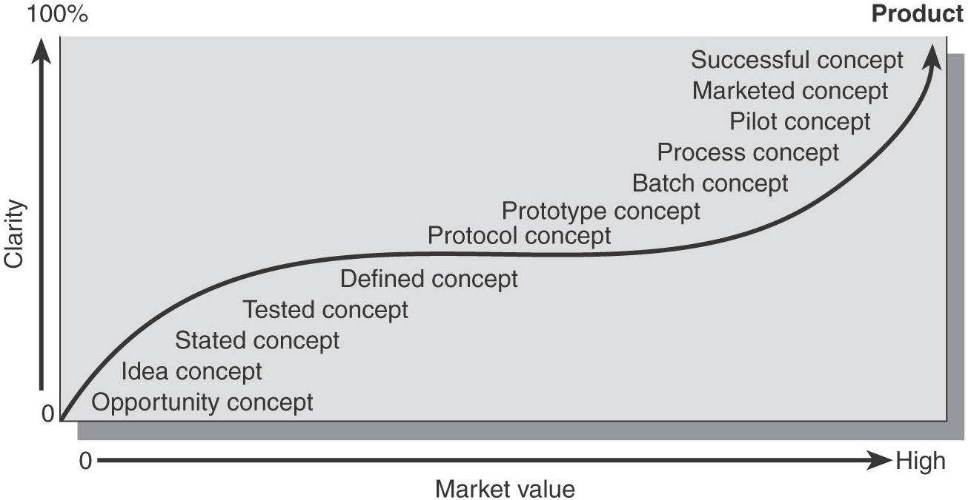
The Life Cycle of a Concept

Slide 47
Other Topics
Pattern Identification and Recognition for Venture Creation (Notes)
Prototype and Exemplar Model (Research Article)
Reverse Engineering
( Notes)

